Slide 1
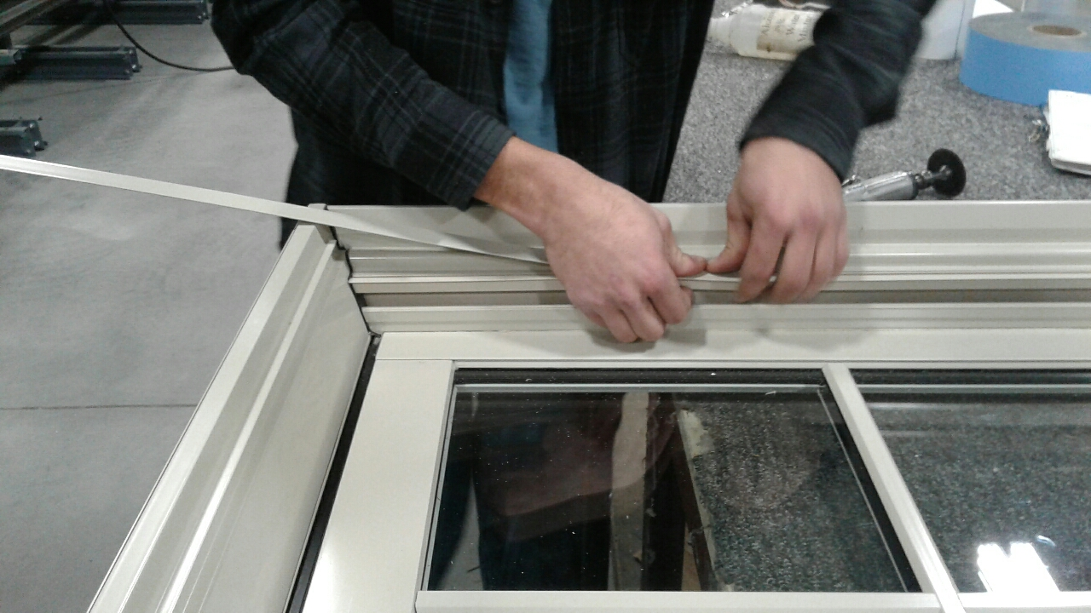
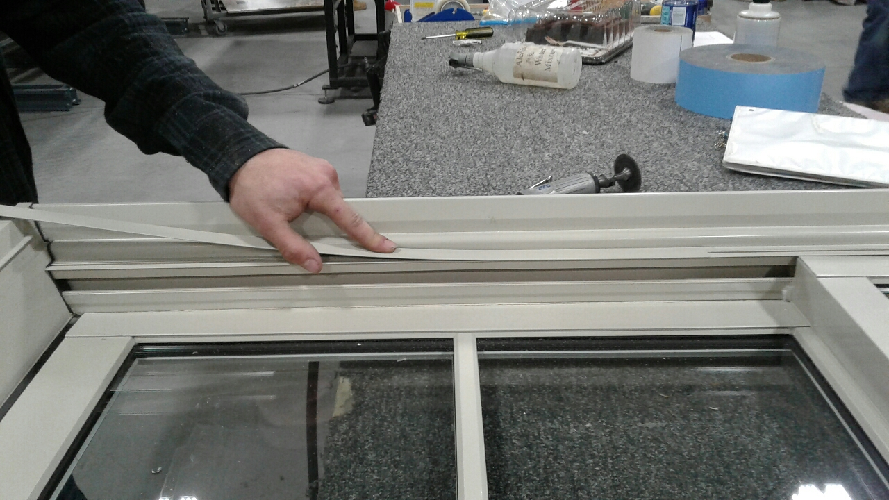

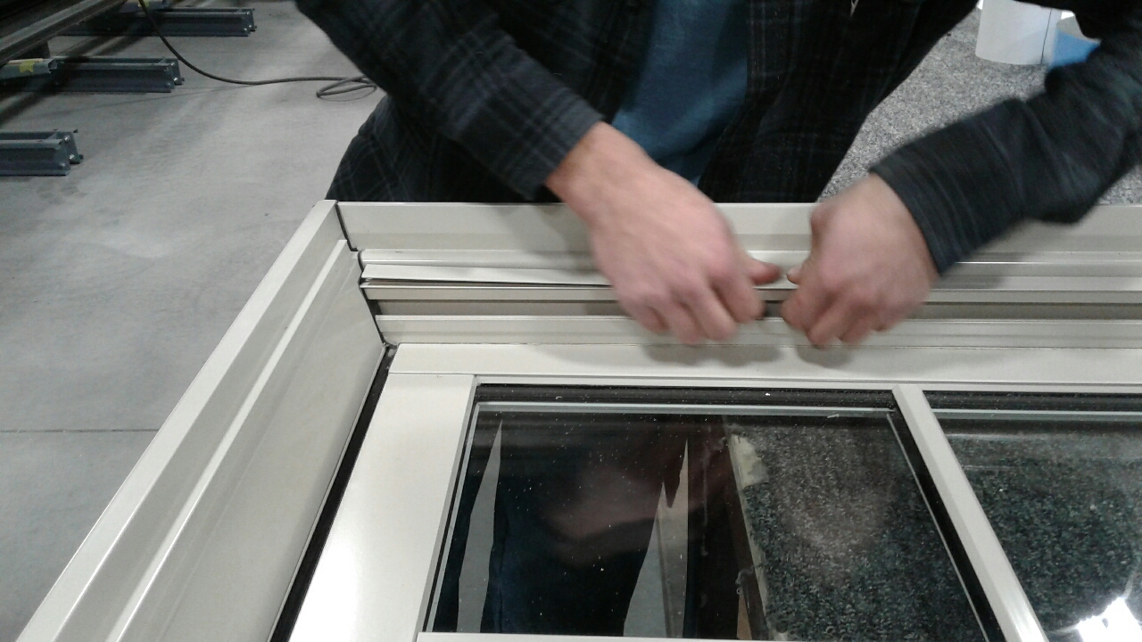
Field installation of the exterior jambliner covers on the Brighton DH
Remove sashes from the window unit. **NOTE- covers can be installed with sashes installed, but will be easier with them removed**
Starting as low as possible in the jambliner of the window unit, snap the first couple of inches of the cover into the receptor groove of the jambliner with your fingers. (See Fig. 1) Applying a bit of dish soap to the leg on the back of the cover may ease the initial snap-in, along with rocking the piece side to side a bit while applying pressure.
Once you are certain that the end of the cover has been snapped into the receptor groove, simply push the cover upward toward the top of the unit until it stops against the frame cladding at the top of the unit. (See Fig. 2)
Complete the installation by snapping the remaining length of the cover into place. (See Fig. 3) This is best accomplished by starting from the point where the cover was initially snapped into the track, and working your way toward the bottom.
Figure 1
Figure 2
Figure 3

